Slide 1
EEOB 546 Final Project
Brianna Griffin, Carter Newton, Kaitlin Higgins, McKenzie Wishman

Slide 2
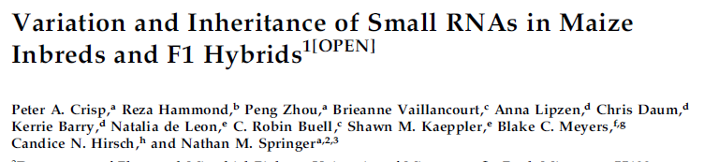
Examined role of small RNAs in maize heterosis.
8 inbred lines, 21 hybrid lines
5 tissues (Root, Endosperm, Seedling, Internode, Leaf)
Notes:
Published in 2020

Slide 3
Idealized pipelines
Small RNA
Fastq-dump
fastqc
Trimmomatic
Bowtie
featureCounts
Read into R
(or prepro.py)
mRNA
Fastq-dump
fastqc
Trimmomatic
STAR
featureCounts
Read into R
Count processing
Read bam files into R
Use packages; purrr, tidyverse, GenomicRanges, DESeq2
Create raw counts
Normalize counts

Slide 4
Problems with generating counts
Dependencies in small RNA pipeline outdated and unavailable
NCBI said half the accessions did not exist through fastq-dump
Low alignment rates with bowtie
Splitting data based on read size difficult
Notes:
Nay impossible

Slide 5
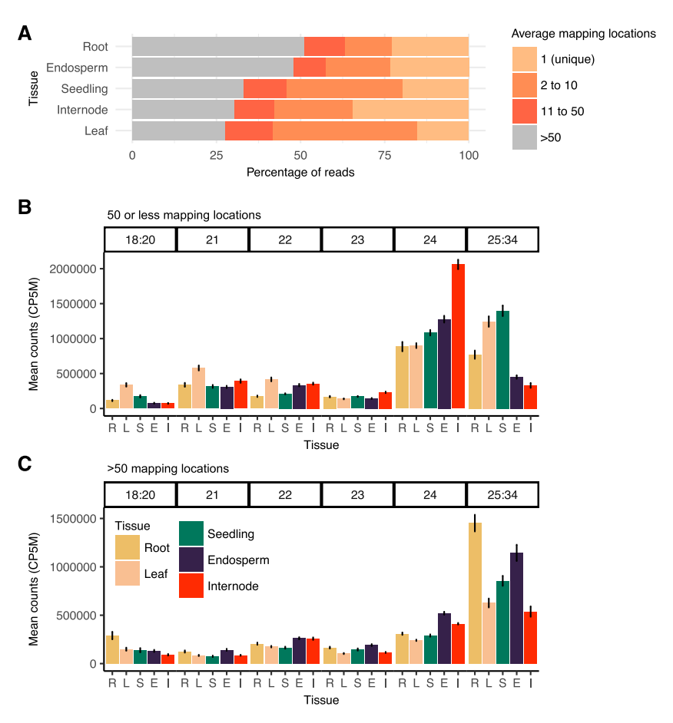
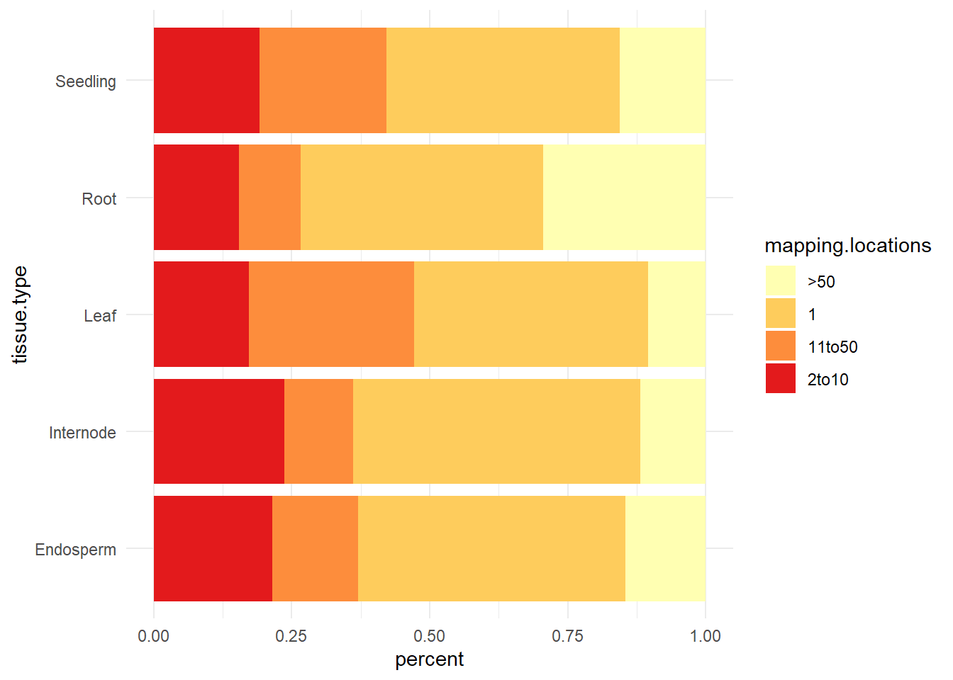
Figure 1 Original vs Reproduced

Slide 6
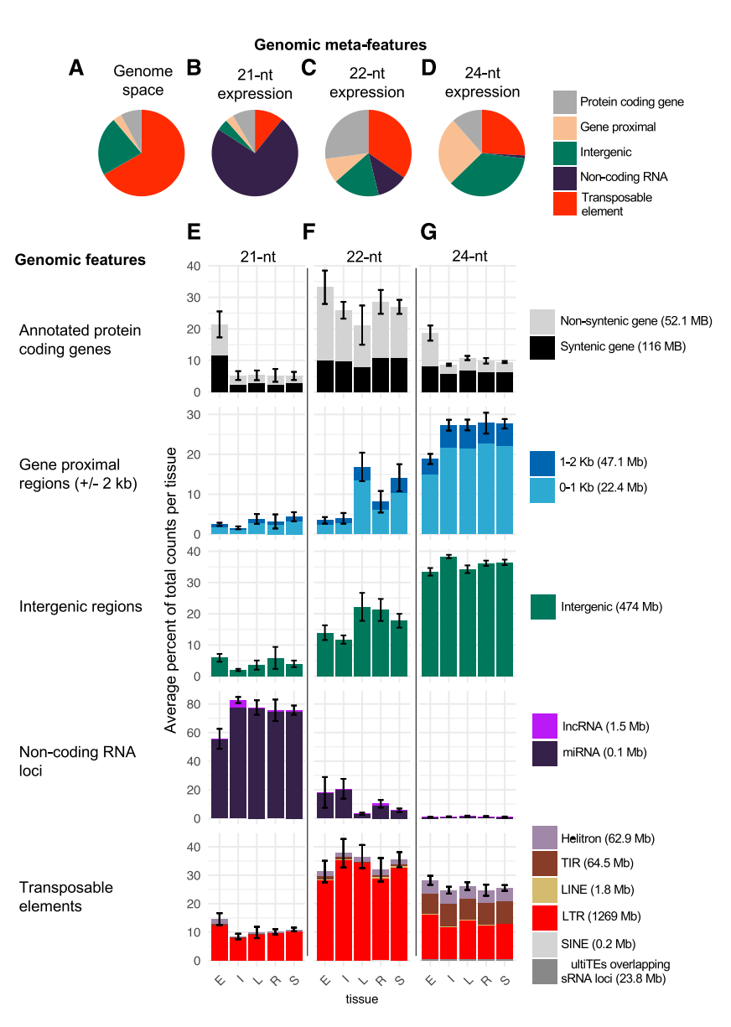
Figure 2

Slide 7
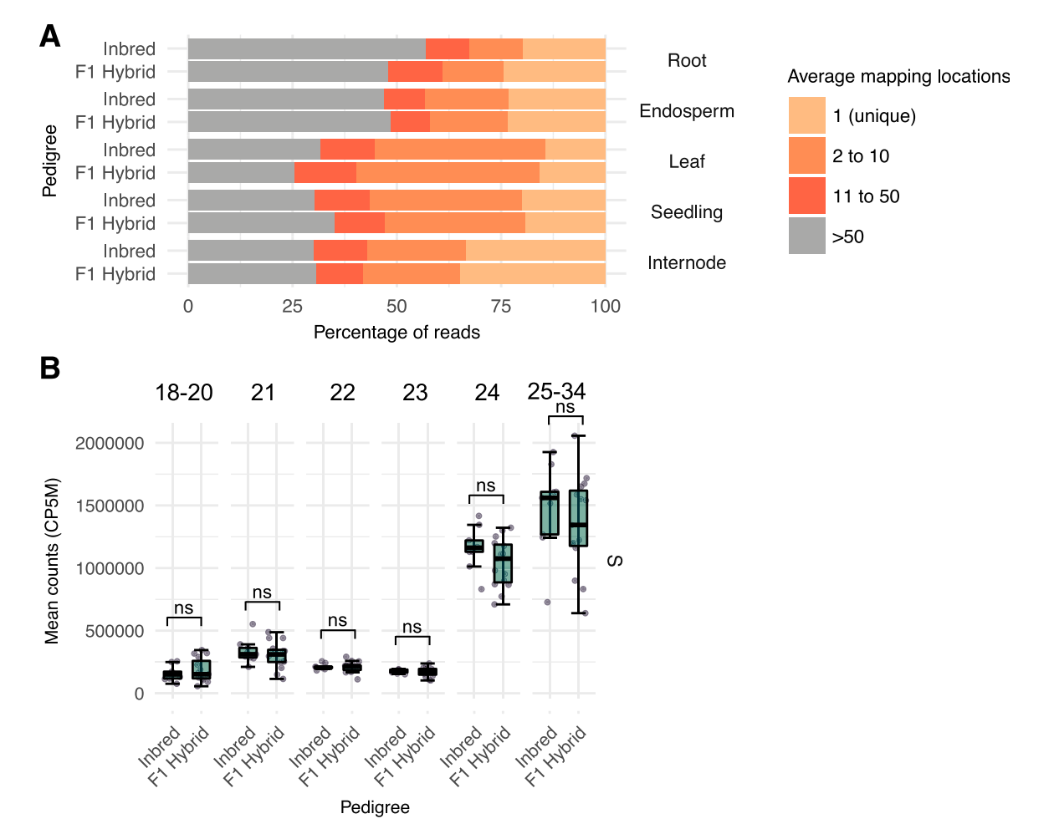
Figure 3
Notes:
Comparisons of sRNA profiles in in- breds relative to hybrids
Analysis of variance is a statistical method that separates observed variance data into different components to use for additional tests
A two-way ANOVA is used to estimate how the mean of a quantitative variable changes according to the levels of two categorical variables. Use a two-way ANOVA when you want to know how two independent variables, in combination, affect a dependent variable.

Slide 8
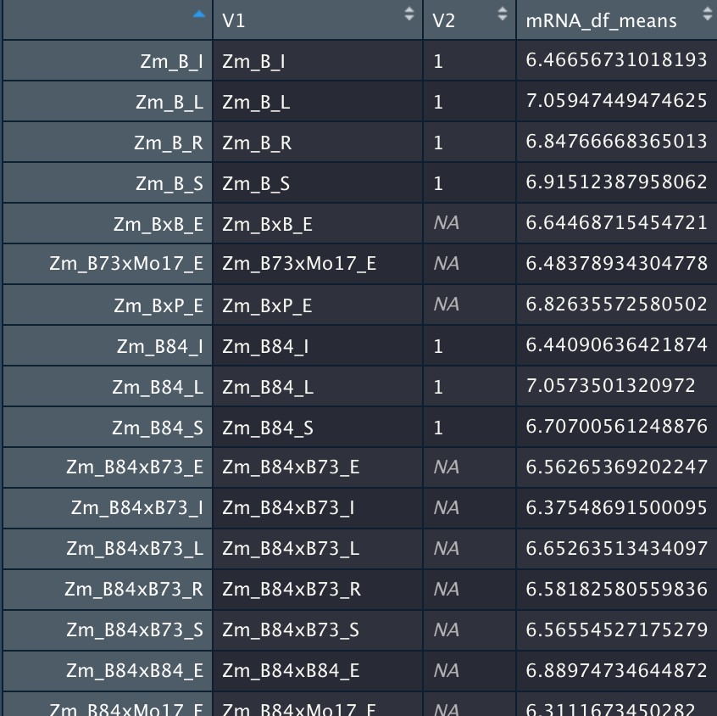
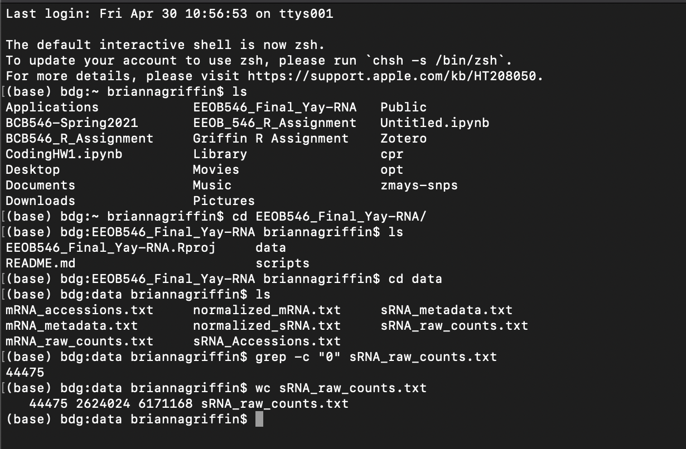
Problems with ANOVA
Notes:
sRNA didnt work
Tried to do mRNA version and was manipulated the mRNA dataframe to get it into the format that the 2 way ANOVA works so the middle column is the inbred hybrid codified and the right is the means but we dont have the read length data so couldnt actually do a proper two way anova so it is failing

Slide 9
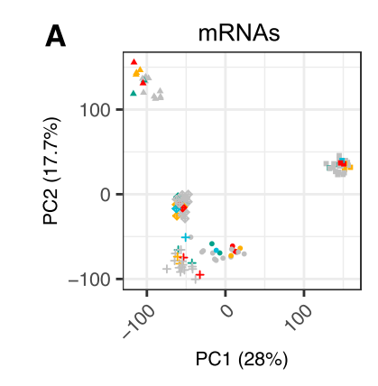
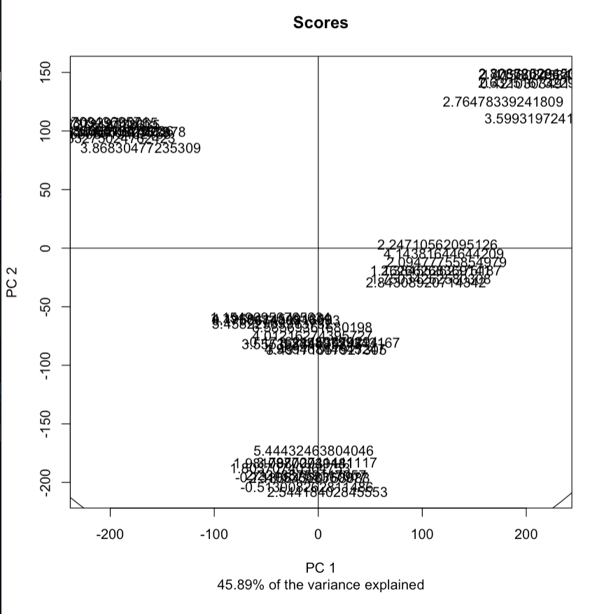
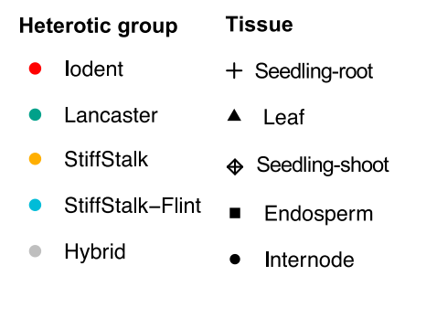
Figure 4 Original vs Reproduced
Notes:
Principal Component Analysis used to access data for trends
The author has

Slide 10
Problems with Running the PCA
Authors said “clustered using singular value decomposition (flags: scale 5 uv, center 5 T, method 5 svd)” but code would not run with svd and automatically would switch to nipals
Authors said only used pcaMethods package, but clearly used something else to make the image look nicer
Notes:
Svd: singular value decomposition does not allow for missing values in the data
Nipals: non linear interactive partial least squares which can be used for the first few or all PC with the decomposition can be accommodated for missing values
Magic matrix algebra does computation mathematics stuff beyond scope of class they calculate eingenvectores

Slide 11
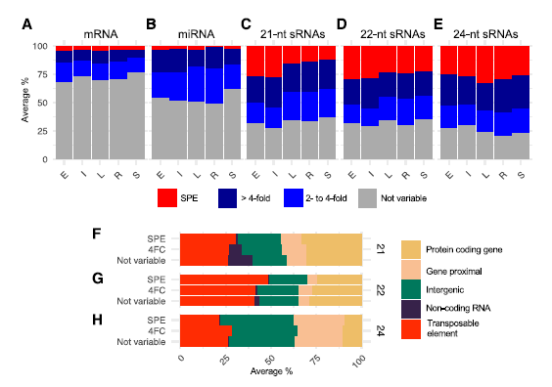
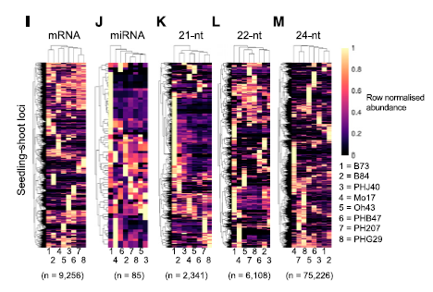
Figure 5 Original (have not reproduced yet)
Notes:
Kaitlin: I had a goal of reproducing this image but ran out of time due to trying to fix the counts and everything. We can remove this slide if it seems unnecessary

Slide 12
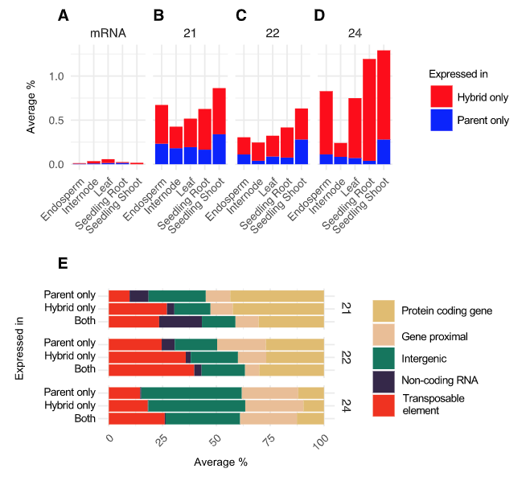
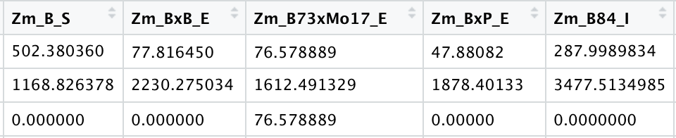
Figure 6 Original vs. Reproduced

Slide 13
Summary
Please, just publish your code when you publish a paper.
Notes:
We can change this if we want to.

